Slide 1
Unit 11 Comparison of Various CMS Tools • Comparative analysis of features of CMS Tools

Slide 2
WordPress versus Joomla
WordPress is used to create a blog, website, and mobile applications
WordPress is developed by its founders, American developer Matt Mullenweg and English developer Mike Little, on 27 May 2003.
WordPress does not support various languages,
WordPress is user-friendly for beginners with a small learning curve.
It is written in the PHP language and connected with MySQL and MariaDB database.
Joomla is used to publish the web component and develop dynamic websites and online applications.
Joomla was developed by Open Source Matters Inc. and the Joomla community in 2005.
Joomla supports multiple languages and provides the capability to manage these languages.
It is more complex than WordPress, and it takes time to learn.
It is written in PHP language and uses OOP techniques and software design patterns. It supports various databases such as MS SQL, PostgreSQL, MySQL, etc.
Image Source:
https://litextension.com/blog/wp-content/uploads/2022/02/joomla-vs-wordpress-info-chua%CC%82%CC%89n.png

Slide 3
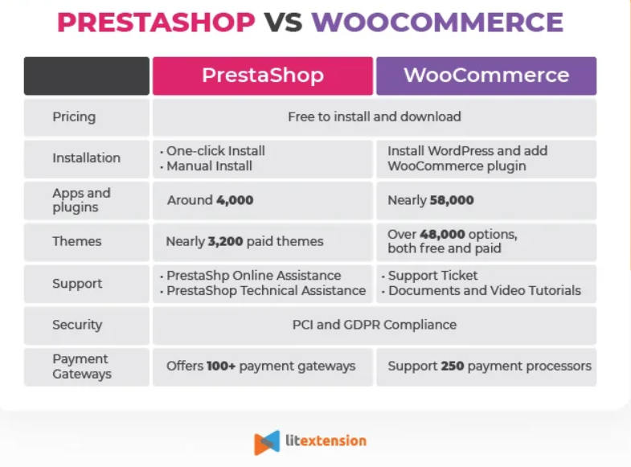
WordPress (WooCommerce) versus Prestashop
Image Source:
https://litextension.com/blog/wp-content/uploads/2021/10/PrestaShop-vs-WooCommerce-Infographic.webp

Slide 4
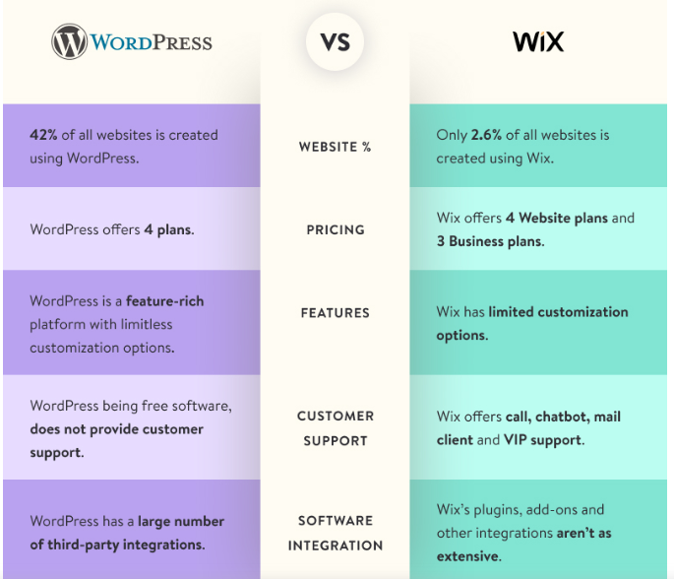
WordPress versus Wix
Image Source:
https://www.creolestudios.com/wp-content/uploads/2021/09/wordpress-vs-wix-detailed-comparison.jpg

Slide 5
WordPress versus Moodle
Moodle
Moodle is an open source learning management system with hundreds of millions of users around the globe and translated into over 100 languages
used by organizations to support their education and training needs.
Moodle when compared to WordPress is heavy in terms of server requirements as all additional plug-ins that comes with Moodle are all related to e-learning in one way or other.
Wordpress-
Wordpress is an open-source publishing platform
popular with bloggers, and a content management system, known for its simplicity and modifiability. Websites may host their own blogging communities, controlling and moderating content from a single dashboard.
WordPress PHP and server requirements are the minimum environmental settings to produce a well-working website.
Image Source:
https://www.slideshare.net/AllThingsOpen/you-dont-have-to-moodle-ways-to-leverage-the-power-of-wordpress-for-online-courses

